Slide 1
Object Oriented Bootcamp
Notes:
Class contract (Phones, timings, turn based talks, no gadgets)
Doodling or Kinesthetic tools
Object principles (Encapsulation, Inheritance and Polymorphism). Take a poll a plot a pie

Slide 2

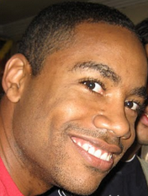
Who are we?
Saleem Siddiqui
saleem@thoughtworks.com
Damon Maneice
dmaneice@thoughtworks.com
Notes:
Put pictures of trainers here

Slide 3
Introductions
Who are you?
What do you do?
Why are you here?
All in 30 seconds or less.
Notes:
TIMING:
Introductions: < 5 minutes
Group Juggle: 5 – 8 minutes
Follow introductions with Group Juggle…
http://wilderdom.com/games/descriptions/GroupJuggle.html
Group Juggle
Fun way to start working together.
Can be used to learn names and develop a sense of interconnectedness.
Stand in a circle, toss a ball to someone, using his/her name, and they in turn toss it to someone else, using the next person's name.
Keep it going, then more balls are introduced and it starts gets crazy.
How to Run a Group Juggle Session
Set up & instructions for 1st round of group juggling
Arrange participants in a circle, not too close, not too far from one another
Include yourself in the circle
Explain that you are going to throw a ball to someone - pick someone out & ask their name, then say
"Hi Freddy, my name is James...here you go!" [underarm throw a ball to Freddy]
Freddy then says "Thank you James", picks someone and says "Hi X, my name is Freddy...here you go!" [throw]....they say "Thank you, Freddy] and on we go.
If you're not trying to learn names, skip the naming part & just throw!
The challenge from here is simply to get the ball thrown around to everyone in the circle, and finally back to the trainer.
2nd round of group juggling
I then say, "Right, well done, now let's see if we can that again - making sure we use the same order, and using each other's names. Remember to say the name of the person you are throwing to, and thank the person, by name, for throwing it to you, OK?"
On the second round, most people will be challenged to remember who to throw it to, and the two names! Take it slow, help the group out, so that each person has a successful second round.
3rd round of group juggling
I then say, "Good, so how about we do it again, but this time, let's let's see how fast we can do it, OK? Here we go...Hi Freddy, my name is James...." [throw]
It will go pretty fast this time, and the group will probably feel quite pleased with themselves.
4th round of group juggling - introducing more balls
I then say, "That's great, but I think you can do faster than that. Come on, let's see how we can really go..." [I then throw and say the name with super fast enthusiasm to set the tone!]
After the first ball has passed through a few hands, I take a 2nd ball out of my pocket (surprise!), and casually, but earnestly say "Hi Freddy...." [throw].
By now everyone is so well trained, the 2nd ball will automatically keep going, and there will be a detectable sense of challenge/excitement.
After a bit, I introduce a 3rd and 4th ball, up to about 6 balls.
Usually I let 4 to 6 balls be juggled for a while (note the balls will be coming back again to the trainer - just keep them going). A group of 12 adults can usually handle 4 to 6 quite well.
If I'm feeling conservative, I just let the group have the success of doing this number of balls, and collect them in when that seems to have been achieved.
But usually, once the group seems competent at 4 to 6 balls I gradually then introduce an unmanageable number of balls into the juggle & maybe also weird objects (e.g., kids soft toys) which all gets crazy, fun, out of control, etc. and ends in a hilarious shambles.
Generally doesn't require debriefing.

Slide 4
Housekeeping
Hours
Mobile phones
Break times
Restrooms
Emergencies

Slide 5
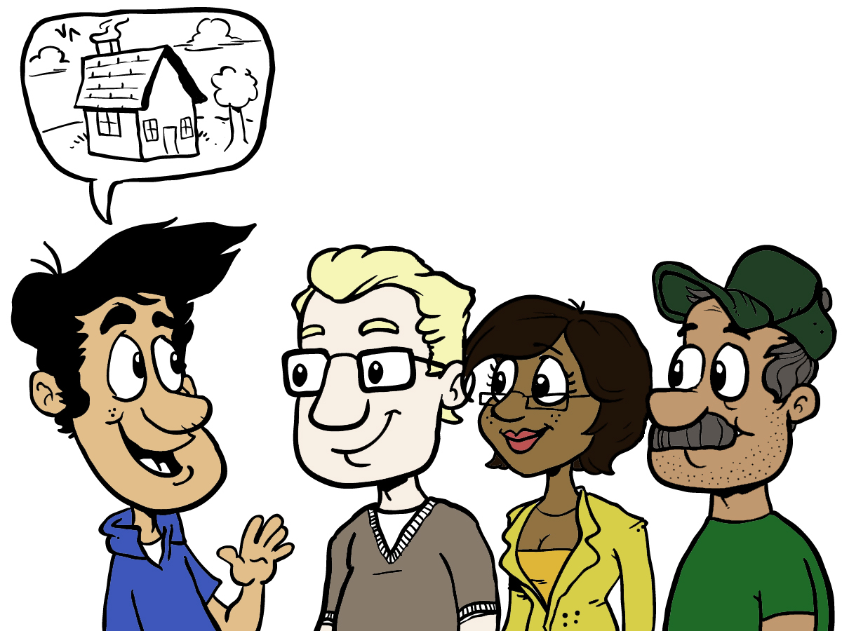
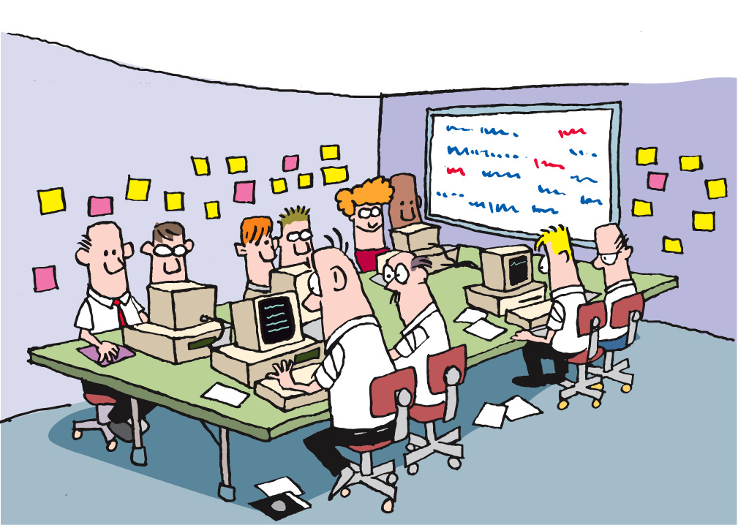
Housekeeping
for(int i=0; i<10; i++) {
System.out.println(“Hello World!”);
}
Notes:
Emphasize that there will be two main modes of learning used during the workshop: Presenting and Learning

Slide 6
Presenting
for(int i=0; i<10; i++) {
System.out.println(“Hello World!”);
}
One conversation
Laptops down
Notes:
Presenting is when someone (could be facilitator but often it’ll be one of the participants) is showing code or other artifacts on the display. During this mode, we’ll need everyone’s attention (laptops down or put aside). Questions and lively conversation is welcome; as long as rules of discourse are obeyed (one conversation at a time)

Slide 7
Coding
Several conversations
Use your inside voice!
Laptops open (of course)
Notes:
Coding is when the attendees will work on the code samples in pairs. This is “heads down” activity, with every pair focused on their workstation/laptop. There will be lots of “low-decibel” conversations (one per pair) in the room. The facilitators will help the attendees. The attendees will help each other as well. There will be a gentle “hum” of these several conversations in the room during the Coding mode.

Slide 8
Context Setting
We will review many concepts and write a lot of code to better understand principles and practices of object oriented code.
This is not a custom class for your organization.
We will try to address various advanced topics, but some are too complex to get into.
Your next steps are to identify how to apply the principles and practices you learn here to the code you write for your organization.

Slide 9
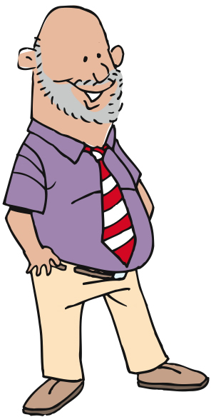
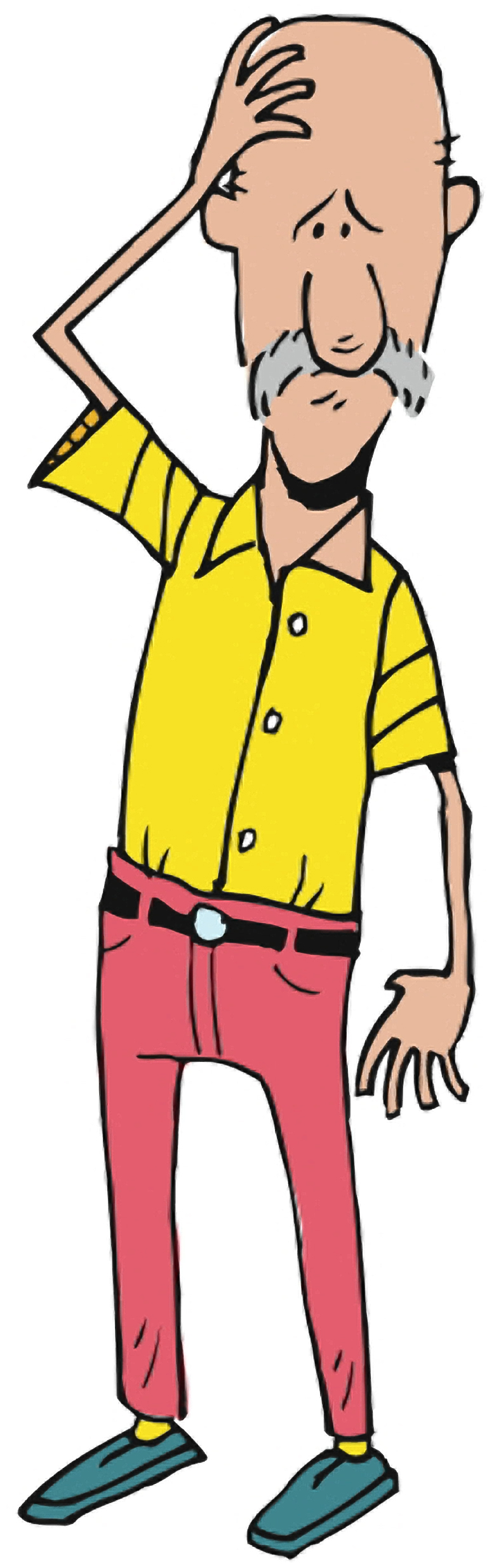
Why are we here?
Hopes
Concerns
Notes:
Capture hopes and concerns about both the course and the organization’s adoption of Agile.
TIMING: 3 – 5 minutes

Slide 10
What’s coming up…
Artifacts in the room
Coding problems
Area and perimeter
Chance
Units of Measure
Stocking a store
Notes:
TIMING: <= 2 minutes
Just a sentence or two about each topic

Slide 11
As a math student, I want to represent a rectangle
Notes:
Job of a class, naming conventions
Extra features like diagonal
Commented out code, duplicate code

Slide 12
As a math student, I want to represent a rectangle, so that I will be able to calculate area
Notes:
Job of a class, naming conventions
Avoid getters and setters, encapsulation
Extra features like diagonal
Commented out code, duplicate code
Things to talk about
Pairing (Driver navigator, Ping pong, Ball and Board)
TDD, Refactor
Things to introduce
Code smells - God classes, Feature envy, law of demeter
Violations due to Framework limitations like spring – Requires getters

Slide 13
As a math student, I want to represent a rectangle, so that I will be able to calculate perimeter
Notes:
Job of a class, naming conventions
Avoid getters and setters, encapsulation
Extra features like diagonal
Commented out code, duplicate code
Things to talk about
Pairing (Driver navigator, Ping pong, Ball and Board)
TDD, Refactor
Things to introduce
Code smells - God classes, Feature envy, law of demeter
Violations due to Framework limitations like spring – Requires getters

Slide 14
As a math student, I want to represent a square, so that I can calculate its area and perimeter
Notes:
Special instances vs New types

Slide 15
Recap
Notes:
Session objectives
Understand that Object Boot Camp is taught in the Socratic Method and focuses on hands-on labs.
Decide a class contract to follow throughout OBC
Understand basic OO terminology and coding standards
Be able to define the job of a class
Understand encapsulation
Unit testing

Slide 16
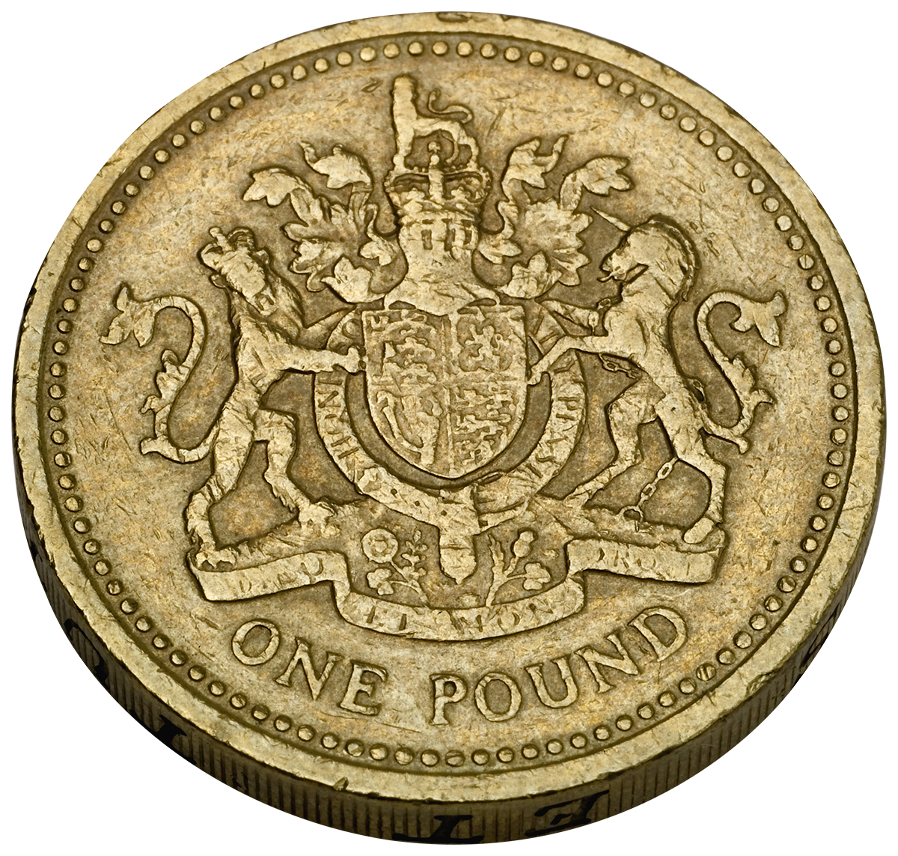
As a math student, I want to represent a chance of getting tails when flipping a coin
Notes:
Represent the chance, don’t expose internals
Restriction of a chance of something happening is between 0 and 1
No constructor tests

Slide 17
As a math student, I want to represent a chance of NOT getting tails when flipping a coin
X
Notes:
Method not should not return primitive.
Equals and Hashcode?
Equals method having unclear variable names
Magic numbers
Discussion
Mutable vs Immutable – Value vs entity objects
Simple design
It works
It communicates
No duplicates
No extra code

Slide 18
As a math student, I want to represent a chance of getting tails when flipping two coins
Notes:
Domain knowledge
Formula P(A && B) = P(A) * P(B)
Common mistakes
Unclear names
Duplication in tests and prod code
Complex setups

Slide 19
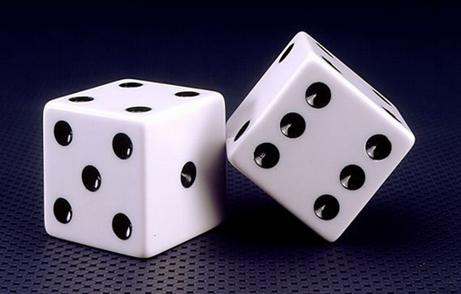
As a math student, I want to represent a chance of getting a 6 and a 5 when throwing two dice
Notes:
Domain knowledge
Formula P(A && B) = P(A) * P(B)
Common mistakes
Unclear names
Duplication in tests and prod code
Complex setups

Slide 20
As a math student, I want to represent a chance of getting at least one tails when flipping two coins
?
Notes:
Domain knowledge
Formula P(A || B) = P(A) + P(B) - P(A) * P(B)

Slide 21
De morgan’s law
P(A||B) = !(!P(A) && !P(B))
Notes:
Churn, chaining
Dead code
toString
Meaningful method names vs comments

Slide 22
Recap
Notes:
Session objectives
Be able to pair program
Understand and use the test-code-refactor cycle
Think about design before they code
Be able to proficiently use the IDE
Understand the value of custom classes over primitives
Understand the concepts of objects churning on each other
Understand logical equality vs. object identity
Understand the use of guard clauses
Follow the general contract when overriding equals(Object)
Know the 4 principles of simple design
Understand and apply YAGNI (You Ain't Gonna Need It)
Understand and apply DRY (Don't Repeat Yourself)

Slide 23
Object interactions
Notes:
What possible types of object interactions?

Slide 24
Delegations

Slide 25
Collaboration

Slide 26
Inheritance

Slide 27
3 != 3
Notes:
Units
Lost a satellite due to imperial and metric conversion

Slide 28
As a math student, I wish to compare lengths in feet and inches
1ft = 12in
Notes:
Unit as a string instead of Enum
Different unit classes for inch and feet
Conversion factor
If-else-elseif

Slide 29
As a math student, I wish to compare lengths in inches and centimeters
2 in = 5.08 cm
Notes:
Unit as a string instead of Enum
Different unit classes for inch and feet
Conversion factor
If-else-elseif

Slide 30
As a math student, I wish to compare lengths in cm and mm
1cm = 10mm
Notes:
Unit as a string instead of Enum
Different unit classes for inch and feet
Conversion factor
If-else-elseif

Slide 31
As a math student, I wish to compare volumes in liter and gallon
1 gallon = 3.78 liters
Notes:
Parallel inheritance trees (ex. Length & Volume classes that are identical). This is a common code smell.

Slide 32
As a math student, I want to be able to add two lengths in inches
2 in + 2 in = 4 in
Notes:
Utility to add lengths

Slide 33
As a math student, I want to be able to add two lengths in any unit and the standard output is inches
2 in + 2.54 cm = 3 in
Notes:
Utility to add lengths

Slide 34
As a math student, I want to be able to add two volumes in any unit and the standard output is liters
1 gallon + 1 liter = 4.78 liters
Notes:
Incompatible units types – Cant add volume and length
Exceptions as flow controls
Utility to add lengths

Slide 35

As a math student, I want to be able to compare temperature in Fahrenheit and Celsius
212 F = 100 C
Notes:
Domain knowledge
Addition of temperatures not possible

Slide 36
Measurement types
State or nominal – Only equality comparison (Blood type)
Ordered or ordinal – All comparisons (Rank)
Scaled or interval – Differences (Temperature, Pressure)
Arithmetic or ratio – Mathematical operations (Volume, Length)
Notes:
Session objectives
Understand the three relationships between objects and their appropriate usages
Inheritance - is a (includes interfaces)
Delegation - one-way relationship
Collaboration - two-way relationship
Understand a good example of using the fewest classes possible
Be able to effectively use slugs
Look at 'else' and 'if' as suspicious statements
Understand when to use checked and unchecked exceptions
Be able to test exceptions
Be able to create factory methods where appropriate

Slide 37
Observer
Composite
Visitor
Adapter
State
Notes:
Why patterns?

Slide 38
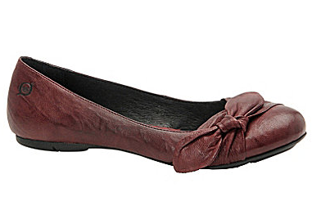
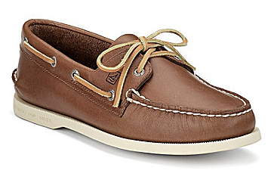
As a store associate, I want to stock the shoe section
Notes:
Observer will not be evident in this

Slide 39
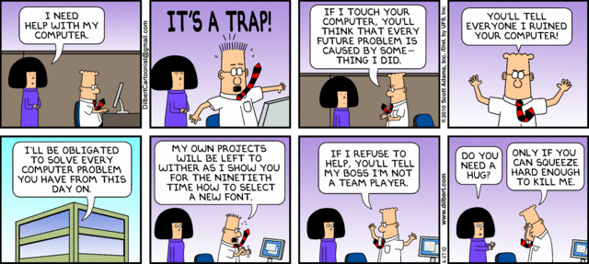
Happy Monday!
Notes:
Humor slide: use (and move around) as needed. Good slide to put up at the beginning of Week 2 entertain and engage the participants as the get settled in.

Slide 40
As a store associate, I want to know when shoe section is fully stocked
Notes:
Observer will not be evident in this

Slide 41
Observer
Composite
Visitor
Adapter
State
Notes:
Why patterns?

Slide 42
As a regional manager, I want to handle more than one store
Notes:
Some people will resolve into observer pattern

Slide 43
As a senior associate, I want an assistant to monitor the shoe section with me
Notes:
Some people will add Assistant class
It is a must to resolve into observer pattern

Slide 44

Notes:
Placeholder slide for “Git”. Useful to remind people to commit to git periodically. Move / use / hide as needed.

Slide 45
Observer
Composite
Visitor
Adapter
State
Notes:
Why patterns?

Slide 46
As a regional manager, I want to know when all my stores are fully stocked
Notes:
Some people will resolve into observer pattern

Slide 47
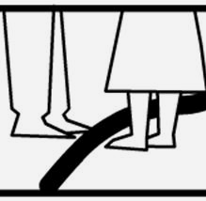
Across The Line
Find your partner
Pull your partner across the line to win a point
You partner can pull you across the line to win a point
Count the points in your head
You have 30 seconds!
Notes:
Warm-up / ice-breaker activity. Useful to encourage pair-swapping. Use / move / hide as necessary.
See “20 activities” micro-book on Amazon for details on this activity.

Slide 48
As a store manager, I want to know when the shoe section is 80% or more stocked so that I can offer promotional discounts
Notes:
80% rule on stocking a shoe

Slide 49
As a store manager, I want to know when the shoe section is 20% or less stocked so that I can order more from the suppliers
Notes:
Observer will not be evident in this

Slide 50
As a civic body, I want to know when the shoe stock is 80% full so I can collect more taxes
Notes:
Observer will not be evident in this

Slide 51
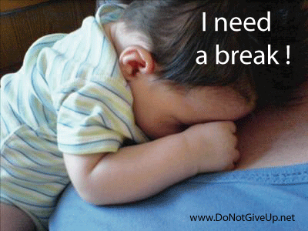
Notes:
Humor slide. Useful to encourage people to take a break. Use / move / hide as necessary.

Slide 52
Parking Lot Slides
p
p
p
p | p
Notes:
The following set of hidden slides relate to the Parking Lot problem. Use this instead of the “Shoe Section” problem in the previous several slides. Use one problem or the other; not both.

Slide 53
As a parking lot attendant, I want to park a car
p
p
p
p | p
Notes:
Observer will not be evident in this

Slide 54
As a parking lot attendant, I want to know when the lot is full
p | p | p | p | p
p | p | p | p | p
p | p | p | p | p
p | p | p | p | p
Notes:
Observer will not be evident in this

Slide 55
As a parking lot attendant, I want to handle more than one parking lot
p | p | p | p | p
p | p | p | p | p
p | p | p | p | p
p | p | p | p | p
p | p | p | p | p
p | p | p | p | p
p | p | p | p | p
p | p | p | p | p
Notes:
Some people will resolve into observer pattern

Slide 56
As a parking lot attendant, I want an assistant to monitor the same parking lots as me
p | p | p | p | p
p | p | p | p | p
p | p | p | p | p
p | p | p | p | p
Notes:
Some people will add Assistant class
It is a must to resolve into observer pattern

Slide 57
As a parking lot manager, I want to know when the lot is 80% full so that I don’t assign that lot to a trainee
p | p | p | p
p | p | p | p
p | p | p | p
p | p | p | p
Notes:
80% rule getting inside parking lot

Slide 58
As a parking lot attendant, I want to know when the lot is 20% or less occupied so that I can promote the lot
p
p
p
p

Slide 59
As a civic body, I want to know when the parking lots are 80% full so I can collect more taxes
p | p | p | p
p | p | p | p
p | p | p | p
p | p | p | p

Slide 60
Recap
Notes:
Session objectives
Understand the differences between polling and subscribe/notify
Understand and be able to implement the Observer pattern
Understand the concept of callback
Understand the thinnest wire back - the importance of sending just enough data with the notification
Realize the trade off of breaking encapsulation (slightly) and under certain conditions in order to provide a common solution to a recurring problem
Know the 3 questions of Observer:
Who should you notify?
What should you tell them?
When should you tell them?

